Slide 1
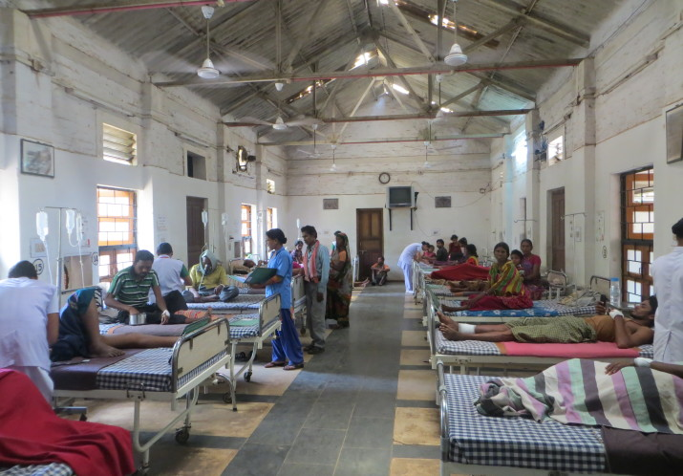
Module 3: India’s Rural Health System
HS 142 Elective: Introduction to India’s Health System
5th Semester BTech –IIT Guwahati
24th August, 2022(Wednesdasy)
Dr Daksha Parmar
Assistant Professor-Development Studies, HSS Department
Source: JSS, Chattisgarh

Slide 2
Population Norms for Rural Health System
Health Institution | Plain Areas | Tribal/Hilly Areas
Sub Health Centres | 5,000 | 3,000
Primary Health Centres | 30,000 | 20,000
Community Health Centres | 1,20,000 | 80,000
Source: Rural Health Statistics, MoHFW, Government of India, 2017

Slide 3
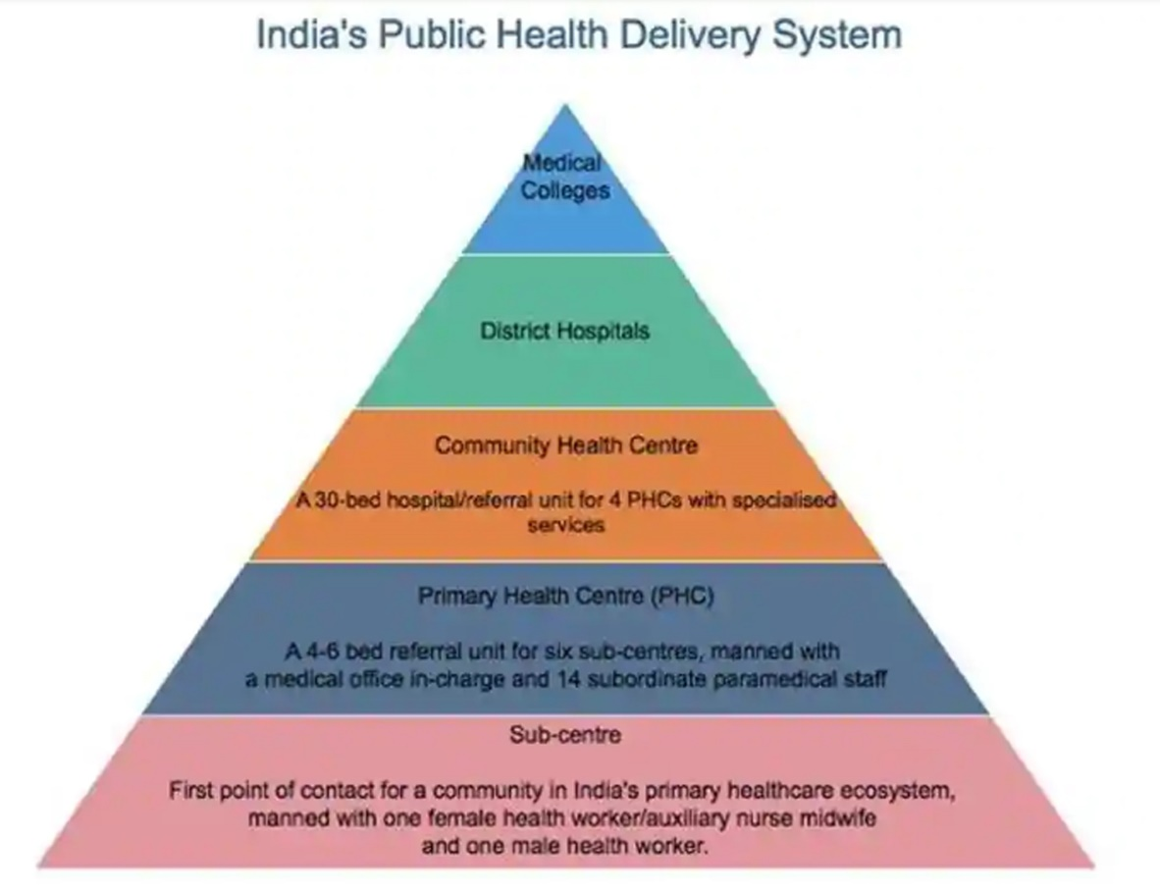

Slide 4
Average Population Covered by Health Facility in India 2019

Slide 5
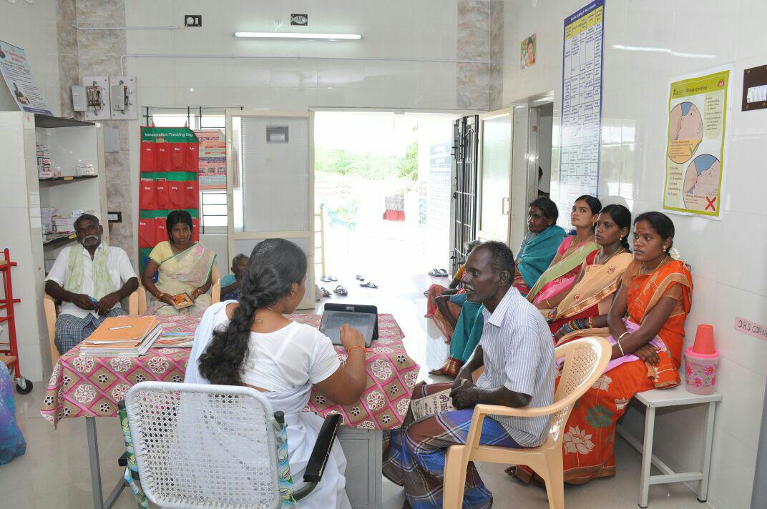
Sub Health Centres
It is the first contact point between the health care system of India and the community.
The Sub-centres are vital peripheral institutions for providing primary health care to the people at the grassroots level.
Provide services in relation to maternal and child health, family welfare, nutrition, immunization, diarrhoea control and control of communicable diseases programmes.
Manpower: One Auxiliary Nurse Midwife(ANM); One Male Health Worker also known as Multi-Purpose Worker(MPW).
One lady health visitor (LHV) is entrusted with the task of supervision of six Sub Centres.
A Medical Officer (MO) from the PHC will either visit the Sub Centre either once or twice in a month.
A Sub-Centre must have its own building with separate rooms for observation, clinic and residence of the ANM
As on 31st March, 2019, there are 157411 numbers of rural SCs functional in the country.
Outpatients at the health sub-centre at Viralimalai block in Pudukottai district in Tamil Nadu.
Source: Scroll.in

Slide 6
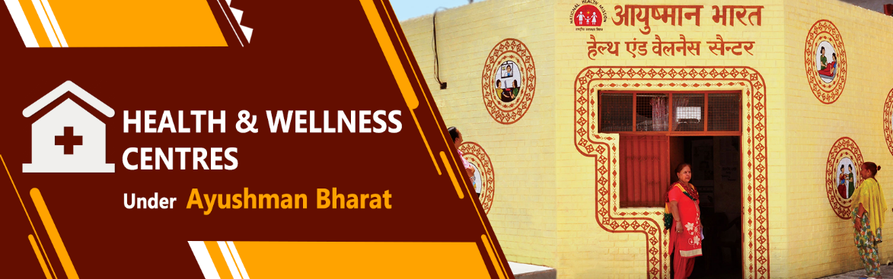
From SCs to HWCs
Sub-centres are expected to provide promotive, preventive and few curative primary health care services
Focus in on providing Outreach Services-Door to Door visits
Maternal and Child Health; Nutrition Diarrhoea Control, Family Welfare, Immunization, Control of Communicable and Non Communicable Diseases
In February 2018, Government of India decided to convert 1.5 lakhs Sub-Centres to Health and Wellness Centres

Slide 7
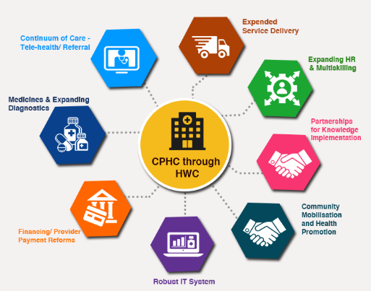
Health and Wellness Centres(HWCs)
Source: MoHFW

Slide 8
Classification of HWCs as per Indian Public Health Standards(IPHS-2022)
Health and Wellness Centres - Sub Health Centre:
a) Health and Wellness Centre - Sub Health Centre in Rural areas
b) Urban Health & Wellness Centre in Urban areas (15,000-25,000 population).
HWC-Sub Health Centres: Community Health Officers (CHOs), Auxiliary Nurse Midwife (ANMs), Multi Purpose Workers(MPWs) and one ASHA per 1000 population-TEAM of CPHC.

Slide 9
Service Provision at HWCs
Go beyond first contact care.
Critical role in the prevention of several disease conditions-communicable and chronic diseases.
Undertake public health functions-community engagement.
Meet people’s needs through a process of population enumeration, regular home and community interactions and improving people’s participation.
Health promotion, early identification, ensuring treatment adherence, follow-up care, ensuring continuity of care by appropriate referrals, optimal home and community follow-up and disease surveillance.
Clinical services-Outpatient care and platform for teleconsultation as well as expanding the range of diagnostics-two-day care beds.
Provides two-way referral services to primary and secondary level facilities-equipped ambulances.

Slide 10
SCs functioning without Health Workers
Source: Rural Health Statistics

Slide 11
Primary Health Centres
PHC is the first contact point between village community and the Medical Officer-Doctor
The PHCs were envisaged to provide an integrated curative and preventive health care to the rural population
It has around 4-6 beds for inpatient care.
Manpower: 1or 2 Medical Officers with 12-14 Paramedical staff.
PHC provides 24*7 services to its population.
Outpatient Services, In-patient Services, Emergency Medical Care, Basic laboratory and diagnostic services, MCH Services.
At the national level, there are 24855 PHCs functioning

Slide 12
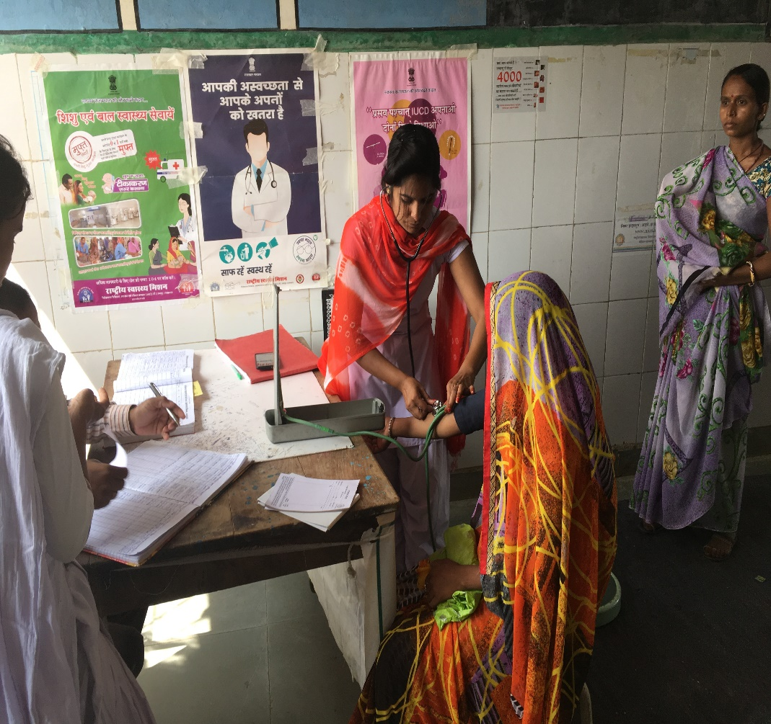
Manpower at PHC in India
Sr.No | Staff | Essential
1 | Medical Officer-MBBS | 1
2 | Medical Officer-AYUSH | 1
3 | Accountant cum Data Entry Operator | 1
4 | Pharmacist | 1
5 | Pharmacist-AYUSH | 1
6 | Nurse Midwife(Staff Nurse) | 3
7 | Health Worker (Female) | 1
8 | Health Assistant(Female) | 1
9 | Health Assistant/Lady Health Visitor | 1
10 | Health Educator | 1
11 | Laboratory Technician | 1
12 | Cold Chain Vaccine Logistic Assistant | 1
13 | Multi-Skilled Group D Worker | 2
14 | Sanitary Worker-Watchman | 1
An Auxiliary Nurse Midwife conducts a health check at a primary health Centre in Rajasthan. Source: Scroll.in
Source: IPHS –GoI 2012

Slide 13
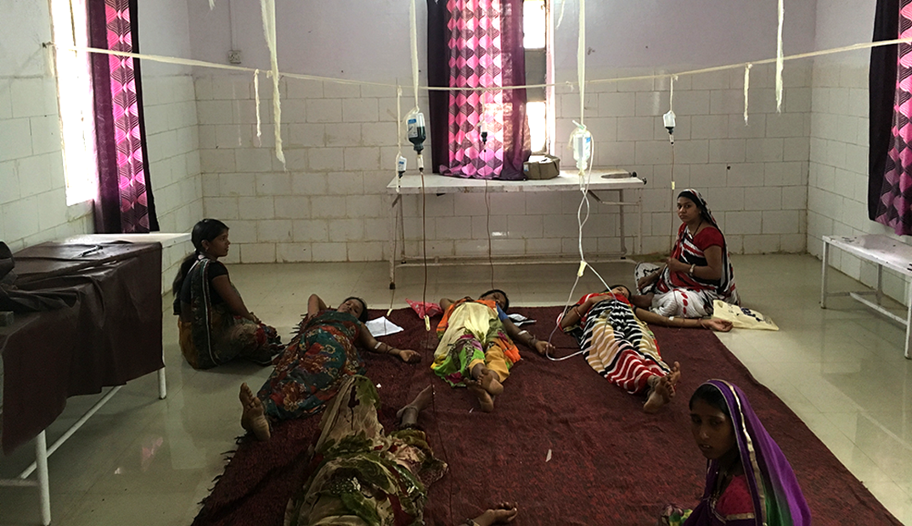
PHCs-Contd
PHC acts as a Referral Unit for 6 Sub Centres.
The activities of PHC involve curative, preventive, promotive and family welfare services
It refers out cases to CHC (30 bedded hospital)
PHC constitutes the backbone of the present health services in India
Anaemic pregnant women get their doses of iron-sucrose intravenously in Dalot PHC, Pratapgarh district- Source Scroll.in

Slide 14
Shortages of Health Manpower at SCs and PHCs
Rural Health Statistics, 2018-19

Slide 15
Community Health Centres(CHCs)
CHC is a 30-bedded hospital providing specialist care in Medicine, Physician, Obstetrics and Gynecology, Surgery and Pediatrics, and Anaesthesiologists.
4 PHCs are included under each CHC thus catering to approximately 80,000 populations in tribal/hilly/desert areas and 1,20,000 population for plain areas
CHCs acts as block level health administrative unit and gatekeeper for referrals to higher level of facilities-Block/Taluka/Tehsil/Circle Level.
Services: Inpatient and Outpatient services.
It should have one Operation Theatre, X-ray, Labour Room, Blood Storage Services and Laboratory facilities.
Pharmacy-with all the essential drugs; Wards-Males and Female; Residential Quarters.
Manpower: CHC is required to be manned by four medical specialists i.e. Surgeon, Physician, Gynecologist and Pediatrician supported by 21 paramedical and other staff.
It serves as a referral centre for 4 PHCs and also provides facilities for obstetric care and specialist consultation

Slide 16
Rural Health Statistics, 2018-19

Slide 17
Vacancy and Shortages of Specialists at CHCs

Slide 18
Sub District/Division Hospitals
Sub-district (Sub-divisional) hospitals are below the district and above the block level (CHC) hospitals and act as First Referral Units (FRUs) for the Tehsil/Taluk/blocks in which they are located.
They form an important link between SC, PHC and CHC on one end and District Hospitals on other end.
Bed Capacity of 31 to 100 in SDH-and caters to about 5-6 lakhs population
Comprehensive care: OPD, IPD, Specialist services and emergency services are provided through these Subdistrict hospitals and they receive referred cases from neighboring CHCs, PHCs and SCs.
A staff of around 20 doctors of different specialties, 45 paramedical staff, 20 administrative staff, and support staff.
For 5-10 lakhs population there should be one Sub District Hospital (IPHS 2022).

Slide 19
District Hospitals (DH)
Every district should have at least one district hospital.
Bed strength varies from 75 to 500 beds depending on the size, terrain and population of the district.
Provide all basic specialty services and develop super-specialty services apart from routine OPD, indoor, emergency services, accident and trauma, dialysis and new born care.
Specialists like surgeon, physician, obstetrician and gynaecologist, paediatrician, orthopaedic surgeon, ophthalmologist, anaesthetist, ENT specialist and dentist have been placed in the district headquarter hospital.
Provisions for quality assurance in clinics, laboratories, blood bank, ward unit, pharmacies, and accident & emergency services
The district hospital has a critical role to play in delivery of clinical care, knowledge hub and health professional training.

Slide 20
Tertiary Teaching Hospitals and Medical Colleges
All India Institute of Medical Services(AIIMS-New Delhi)-1956 premier Medical Institution and College.
In 2006, six AIIMS-like medical institutes were announced in Patna, Bhopal, Raipur, Bhubaneswar, Jodhpur and Rishikesh.
16 new AIIMS have been approved of which 9 will be fully functional by 2022.
Mangalagiri (Andhra Pradesh), Guwahati (Assam), Rajkot (Gujarat), Bilaspur (Madhya Pradesh), Deoghar (Jharkhand), Nagpur (Maharashtra), Bathinda (Punjab), Gorakhpur (Uttar Pradesh) and Kalyani in (West Bengal)

Slide 21
Inputs of Health Systems
-Infrastructure
-Health Workers
-Drugs
-Diagnostics and Equipment's
-Health Information Systems
-Finances
Combined together to provide quality health services- that are equitable, accessible, affordable and responsive to the needs of the population.

Slide 22
Levels of Services in Health System
Evolution of a multilevel infrastructure
Three levels of health services: Primary, Secondary and Tertiary Level of Care
Pyramidal regionalization of health services
The right mix of competence and health care technology
Competence and technological needs and uses must be carefully defined to achieve the widest application to the largest population.

Slide 23
Primary Level Care
First contact point.
Serves a defined community/area (PHC and their Sub Centres, Health and Wellness Centres, Dispensaries and Health Posts).
Functions of the PHC range from curative to preventive and promotive activities.
Carries out simple diagnostics and curative activities for patients
Normally has no beds(except few for emergencies and maternity care)
May/may not have a physician, nurse assisted by auxiliary health workers
Low technology, simple equipment's

Slide 24
Secondary Level Care
Secondary level REFERRAL CARE available through CHCs and district hospitals.
A recognized referral facility providing a 24 hour medical care
Deals with more complex problems
Represents a high level of competence(more specialists) than the source of referral.
More beds and sophisticated technology in terms of diagnostic and treatment than the source of referral.

Slide 25
Tertiary Level Care
Most sophisticated hospital located in national or state capital or other big city
Typically a University Teaching Hospital
Providing the highest level of medical care available in the country or a region.
Super Specialist Care with centralized expertise and high-end advanced technology
Is a resource for education, training and consultation.

Slide 26
Three Tier Structure of Public Health Services
Primary care services: Provided by the Sub Centres, Health and Wellness Centres and the Primary Health Centres.
Secondary care services: Community Health Centres, Sub District Hospitals and District Hospitals.
Tertiary care services: Medical Colleges and Teaching Hospitals
To provide continuity of care and integrated healthcare to population

Slide 27
Contd
Logic of having levels of care is to judiciously use
Technology
Skills to satisfy the health needs, so that the majority of People have improved healthcare
Resources
Basic Services at the grassroots
High Tech-More Expensive-Located at the Central Level-Can cover large number of people.

Slide 28
Combining Services: Promotive, Preventive, Curative and Rehabilitative
FOUR Stages:
No Disease----Disease----Disability------Death
Promote Health: Improve the general level of health and wellbeing so that conditions of disease process are prevented.
Preventive Services: Interventions so that we do not contract or develop disease
Curative Services: Medical Treatment and Cure
Rehabilitative Services: Rehabilitation of patients after surgery

Slide 29
Thank you

